Slide 1
Chapter 8
Profit Planning
Notes:
Chapter 9 focuses on the steps taken by businesses to achieve their planned levels of profits – a process called profit planning. Profit planning is accomplished by preparing numerous budgets, which, when brought together, form an integrated business plan known as a master budget.

Slide 2
Learning Objective 1
Understand why organizations budget and the processes they use to create budgets.
Notes:
Learning objective number 1 is to understand why organizations budget and the processes they use to create budgets.

Slide 3
The Basic Framework of Budgeting
A budget is a detailed quantitative plan for acquiring and using financial and other resources over a specified forthcoming time period.
The act of preparing a budget is called budgeting.
The use of budgets to control an organization’s activity is known as budgetary control.
Notes:
Budgeting helps managers make decisions about resources needed and financial results expected for the coming period. Budgets are used to control activities of an organization because they set out a plan for the entire organization.

Slide 4


Planning and Control
Planning –
involves developing objectives and preparing various budgets to achieve these objectives.
Control –
involves the steps taken by management that attempt to ensure the objectives are attained.
Notes:
To be effective, a good budgeting system must provide for both planning and control. Good planning without effective control is time wasted.

Slide 5
Advantages of Budgeting
Define goal
and objectives
Communicate
plans
Think about and
plan for the future
Advantages
Coordinate
activities
Means of allocating
resources
Uncover potential
bottlenecks
Notes:
Budgets communicate management’s plans throughout the organization. Budgets force managers to think about and plan for the future. While our focus in this chapter is on preparing operating budgets for a one-year time frame, longer term budgets also can be very helpful to organizations from a planning standpoint.

Slide 6
Responsibility Accounting
Managers should be held responsible for those items — and only those items — that
the manager can actually control
to a significant extent.
Notes:
The premise of responsibility accounting is that managers should be held responsible only for those items that they can control to a significant extent. Responsibility accounting systems enable organizations to react quickly to deviations from their plans and to learn from feedback obtained by comparing budgeted goals to actual results. The point is not to penalize individuals for missing targets.

Slide 7
Choosing the Budget Period
Operating Budget
2005
2006
2007
2008
The annual operating budget
may be divided into quarterly
or monthly budgets.
A continuous budget is a
12-month budget that rolls
forward one month (or quarter)
as the current month (or quarter)
is completed.
Notes:
Operating budgets ordinarily cover a one-year period corresponding to a company’s fiscal year. Many companies divide their annual budget into four quarters. In this chapter, we focus on one-year operating budgets.
A continuous or perpetual budget is a twelve-month budget that rolls forward one month (or quarter) as the current month (or quarter) is completed. This approach keeps managers focused on the future at least one year ahead.

Slide 8
Self-Imposed Budget
A budget is prepared with the full cooperation and
participation of managers at all levels. A participative
budget is also known as a self-imposed budget.
Notes:
A self-imposed budget or participative budget is a budget that is prepared with the full cooperation and participation of managers at all levels. It is a particularly useful approach if the budget will be used to evaluate managerial performance.

Slide 9
Advantages of Self-Imposed Budgets
Individuals at all levels of the organization are viewed as members of the team whose judgments are valued by top management.
Budget estimates prepared by front-line managers are often more accurate than estimates prepared by top managers.
Motivation is generally higher when individuals participate in setting their own goals than when the goals are imposed from above.
A manager who is not able to meet a budget imposed from above can claim that it was unrealistic. Self-imposed budgets eliminate this excuse.
Notes:
Here is a list of four major advantages of self-imposed budgets. The key to self-imposed budgets is to get operational managers involved in the budgeting process and to clearly state their goals and expectations.

Slide 10

Self-Imposed Budgets
Most companies do not rely exclusively upon self-imposed budgets in the sense that top managers usually initiate the budget process by issuing broad guidelines in terms of overall profits or sales.
Notes:
Self-imposed budgets should be reviewed by higher levels of management. Without such a review, self-imposed budgets may have too much “budgetary slack,” or may not be aligned with overall strategic objectives. Most companies do not rely exclusively upon self-imposed budgets in the sense that top managers usually initiate the budget process by issuing broad guidelines in terms of overall target profits or sales. Lower level managers are directed to prepare budgets that meet those targets.

Slide 11

Human Factors in Budgeting
The success of budgeting depends upon three important factors:
Top management must be enthusiastic and committed to the budget process.
Top management must not use the budget to pressure employees or blame them when something goes wrong.
Highly achievable budget targets are usually preferred when managers are rewarded based on meeting budget targets.
Notes:
Without the clear and unconditional support of top management, any budget process is bound to fail. Employees must believe that the budgets prepared are meaningful to the decision process of managers. While budgets help managers control activities, the most successful use of budgeting is to reward behavior that management is trying to encourage.

Slide 12
The Budget Committee
A standing committee responsible for
  overall policy matters relating to the budget
  coordinating the preparation of the budget
Notes:
A budget committee is usually responsible for overall policy relating to the budget program, for coordinating the preparation of the budget, for resolving disputes related to the budget, and for approving the final budget. This committee may consist of the president and vice presidents in charge of various functions, such as sales, production, purchasing, and the controller.

Slide 13
Learning Objective 2
Prepare a sales budget, including a schedule of expected cash collections.
Notes:
Learning objective number 2 is to prepare a sales budget, including a schedule of expected cash collections.

Slide 14
Budgeting Example
Royal Company is preparing budgets for the quarter ending June 30.
Budgeted sales for the next five months are:
  April 20,000 units
  May 50,000 units
  June 30,000 units
  July 25,000 units
  August 15,000 units.
The selling price is $10 per unit.
Notes:
The marketing department of Royal Company prepares the following information that will be used to prepare a budget for the quarter ending June 30th.

Slide 15
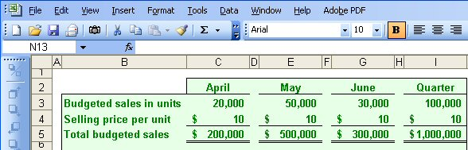
The Sales Budget
The individual months of April, May, and June are summed to obtain the total projected sales in units and dollars for the quarter ended June 30th
Notes:
Royal sells only one product and that product has a selling price of $10 per unit. To calculate the total sales in dollars for any period, we multiply the projected sales in units times the unit selling price. As you can see, Royal forecasts unit sales of 100,000 and total sales revenue of $1,000,000 for the quarter ended June 30th.
Once we complete the sales budget, we can move on to the expected cash collections from sales.

Slide 16
Expected Cash Collections
All sales are on account.
Royal’s collection pattern is:
  70% collected in the month of sale,
  25% collected in the month following sale,
  5% uncollectible.
The March 31 accounts receivable balance of $30,000 will be collected in full.
Notes:
All sales at Royal are made on account. The company collects 70 percent of the sales revenue in the month of sale, 25 percent in the following month, and estimates that 5 percent of all credit sales will prove uncollectible.
At the start of the quarter, Royal had $30,000 in accounts receivable that were deemed to be fully collectible.
Let’s prepare the budget of expected cash collections on sales.

Slide 17
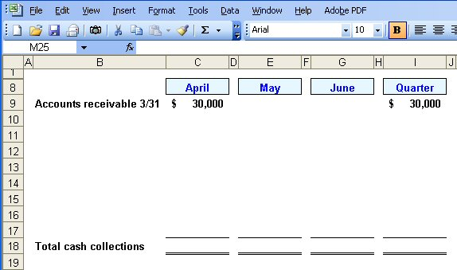
Expected Cash Collections
Notes:
We expect to collect all $30,000 in accounts receivable during the month of April.

Slide 18
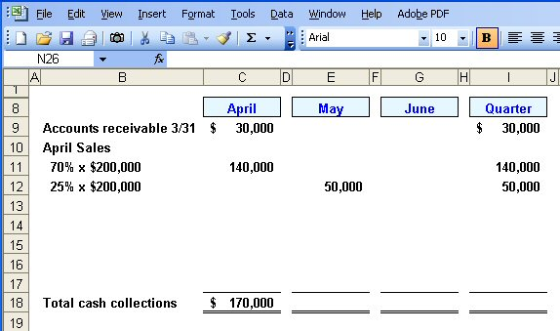
Expected Cash Collections
From the Sales Budget for April.
Notes:
In addition to the $30,000, we expect to collect 70% of the project sales for April of $200,000. So we will collect another $140,000 in April. Notice that 25% of April projected sales will be collected in May. In other words, $50,000 of April sales will be collected in May.

Slide 19
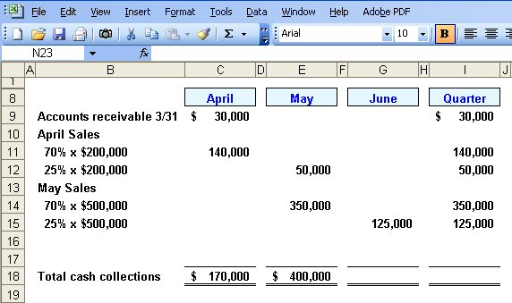
Expected Cash Collections
From the Sales Budget for May.
Notes:
We follow a similar procedure for the month of May. 70% of May projected sales will be collected in May. This amounts to $350,000.
Can you complete the final month of June to get the total expected cash collections for the quarter?

Slide 20
Quick Check ✓
What will be the total cash collections for the quarter?
  a. $700,000
  b. $220,000
  c. $190,000
  d. $905,000
Notes:
Take your time and remember that we are asking for the total cash collections for the quarter ended June 30th.

Slide 21
Quick Check ✓
What will be the total cash collections for the quarter?
  a. $700,000
  b. $220,000
  c. $190,000
  d. $905,000
Notes:
How did you do? We will show you the computations on the next screen.

Slide 22
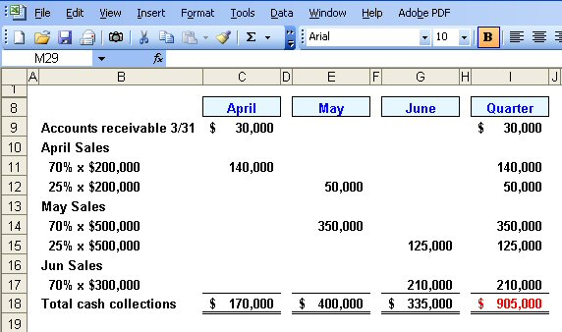
Expected Cash Collections
Notes:
We expect to collect $210,000 from June sales in the month of June. When we carry all the cash collections to the Quarter column, you can see that we expect to collect $905,000 for the quarter.
Now let’s turn our attention to the production budget.

Slide 23
Learning Objective 3
Prepare a production budget.
Notes:
Learning objective number 3 is to prepare a production budget.

Slide 24
The Production Budget
Sales
Budget
and
Expected
Cash
Collections
Production
Budget
Completed
Production must be adequate to meet budgeted
sales and provide for sufficient ending inventory.
Notes:
After we have budgeted our sales and expected cash collection, we must make sure the our production is adequate to meet the forecasted sales and provide a sufficient ending inventory. We need inventory on hand at the end of the period to minimize the likelihood of an inventory stock-out.

Slide 25
The Production Budget
The management at Royal Company wants ending inventory to be equal to 20% of the following month’s budgeted sales in units.
On March 31, 4,000 units were on hand.
Let’s prepare the production budget.
Notes:
The management at Royal wants to minimize the probability of a stock out of inventory items. A policy has been implemented that requires the company to maintain ending inventory of 20 percent of the following month’s budgeted sales. At the beginning of the quarter, Royal had 4,000 units in inventory.
Let’s get started on the production budget.

Slide 26
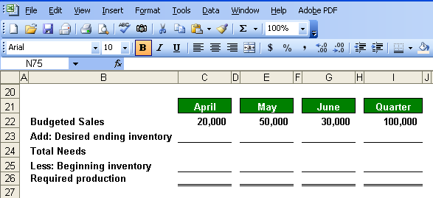
The Production Budget
Notes:
We start our production budget with the budgeted sales in units.

Slide 27
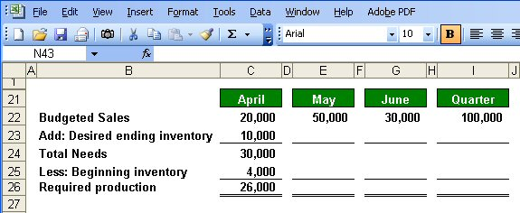
The Production Budget
March 31
ending inventory
Notes:
Part I
Here is the completed production budget for April. Let’s see how we put the budget together. We start the monthly budget with projected sales in units for the month. These numbers come from our sales budget.
Part II
The desired ending inventory is recognition of management’s policy against stock-out of inventory. We determine the number of units by multiplying May’s projected unit sales times the 20% established by management as part of its policy. We add the desired ending inventory in units to the projected sales to get our total unit needs for the month.
Part III
Finally, we subtract the current period’s inventory. In our case, Royal had 4,000 units in inventory at the end of March. We have now calculated our required production for the month of April.

Slide 28
Quick Check ✓
What is the required production for May?
  a. 56,000 units
  b. 46,000 units
  c. 62,000 units
  d. 52,000 units
Notes:
What did you calculate as the required production for May?

Slide 29
Quick Check ✓
What is the required production for May?
  a. 56,000 units
  b. 46,000 units
  c. 62,000 units
  d. 52,000 units
Notes:
The correct answer is 46,000 units. We will show you the calculation of this amount on the next screen.

Slide 30
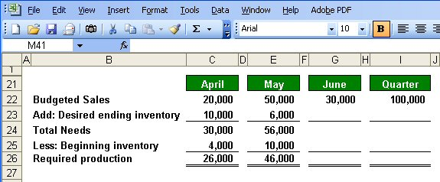
The Production Budget
Notes:
Notice that the desired ending inventory for April becomes the beginning inventory for May.
Now let’s complete the schedule.

Slide 31
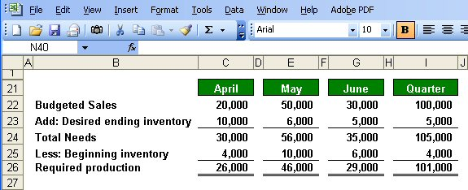
The Production Budget
Assumed ending inventory.
Notes:
Part I
We have assumed an ending inventory on June 30th of 5,000 units. If you refer back to the sales data, July sales units are estimated to be 25,000, and 20% of 25,000 equals 5,000 units.
Part II
The ending inventory at June 30th becomes the ending inventory for the quarter.
Part III
The beginning inventory comes from the March 31st inventory of 4,000 units. Be careful that you don’t just carry the 6,000 units at the beginning of June to the beginning inventory for the quarter column. It is a common mistake.
For the quarter, we will need to produce 101,000 units to meet our sales and inventory goals. Now that we know our required production, let’s look at the direct materials budget.

Slide 32
Learning Objective 4
Prepare a direct materials budget, including a schedule of expected cash disbursements for purchases of materials.
Notes:
Learning objective number 4 is to prepare a direct materials budget, including a schedule of expected cash disbursements for purchases of materials.

Slide 33
The Direct Materials Budget
At Royal Company, five pounds of material are required per unit of product.
Management wants materials on hand at the end of each month equal to 10% of the following month’s production.
On March 31, 13,000 pounds of material are on hand. Material cost is $0.40 per pound.
Let’s prepare the direct materials budget.
Notes:
Each good unit of output requires 5 pounds of direct material. Management does not want to run out of direct materials, so a policy has been established that materials on hand at the end of each month must be equal to 10% of the following month’s production. At the beginning of the month, Royal has 13,000 pounds of direct material on hand. Each pound of direct material costs 40 cents.
Let’s complete the direct materials budget.

Slide 34
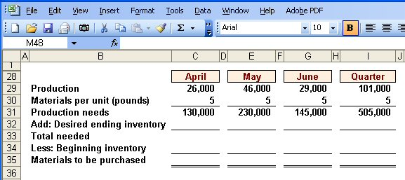
The Direct Materials Budget
From production budget
Notes:
The first step in preparing the direct materials budget is to insert the required production in units from the production budget.

Slide 35
The Direct Materials Budget
Notes:
We begin with our required production from the production budget just completed. We multiply the required unit production by the number of pounds of direct materials needed. Five pounds per unit is used, so for April’s production, we will need 130,000 pounds of direct materials.

Slide 36
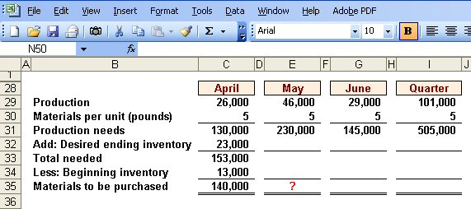
The Direct Materials Budget
March 31 inventory
10% of following month’s production needs.
Calculate the materials to
be purchased in May.
Notes:
Part I
To our production needs, we must add the number of pounds necessary to meet management’s policy regarding minimum inventory levels. The ending inventory for April is equal to 10% of May’s production needs, or 23,000 pounds. The total number of pounds needed in April is 153,000 pounds.
Part II
Finally, we subtract our materials on hand to determine the number of pounds of material that must be purchased. During April, Royal must purchase 140,000 pounds of direct materials.
Part III
Why don’t you calculate the materials to be purchased in May?

Slide 37
Quick Check ✓
How much materials should be purchased in May?
  a. 221,500 pounds
  b. 240,000 pounds
  c. 230,000 pounds
  d. 211,500 pounds
Notes:
What was the result of your calculation?

Slide 38
Quick Check ✓
How much materials should be purchased in May?
  a. 221,500 pounds
  b. 240,000 pounds
  c. 230,000 pounds
  d. 211,500 pounds
Notes:
The correct answer is 221,500 pounds. Let’s see how we got this value.

Slide 39
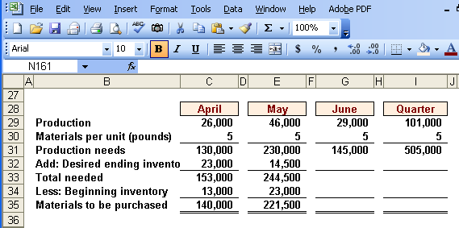
The Direct Materials Budget
Notes:
Recall that the ending inventory in one month becomes the beginning inventory in the next month. You can see that 221,500 pounds of material must be purchased in May. Now, let’s complete the remainder of the schedule.

Slide 40
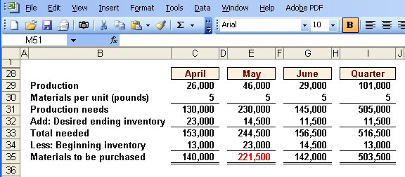
The Direct Materials Budget
Assumed ending inventory
Notes:
Here is the complete schedule for May and June. Once again, you can see that the ending inventory in May becomes the beginning inventory in June. Notice that we assumed an ending inventory of 11,500 pounds. For the quarter, we will need to purchase 503,500 pounds of direct materials.
Did you remember to bring the beginning inventory from April to the quarter column?

Slide 41
Expected Cash Disbursement for Materials
Royal pays $0.40 per pound for its materials.
One-half of a month’s purchases is paid for in the month of purchase; the other half is paid in the following month.
The March 31 accounts payable balance is $12,000.
Let’s calculate expected cash disbursements.
Notes:
Recall that Royal pays 40 cents per pound of direct materials. The company pays for one-half of its purchases in the month of the purchase and one-half in the following month. At the beginning of the quarter, Royal owed creditors $12,000 for purchases of direct materials.
Let’s begin the expected cash disbursement for direct materials schedule.

Slide 42
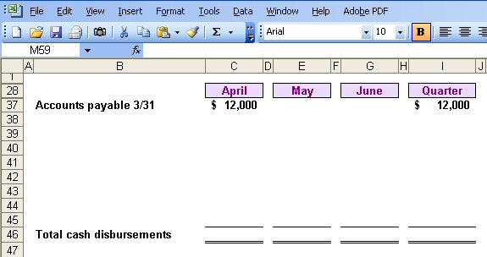
Expected Cash Disbursement for Materials
Notes:
We will pay the $12,000 from March in the month of April.

Slide 43
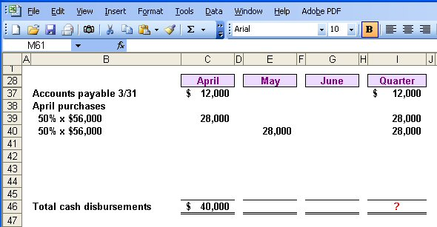
Expected Cash Disbursement for Materials
Compute the expected cash
disbursements for materials
for the quarter.
140,000 lbs. × $.40/lb. = $56,000
Notes:
In addition to the $12,000, Royal will pay one-half of the cost of purchasing 140,000 pounds of direct material at 40 cents per pound ($56,000).
Please complete the schedule for the quarter and see how your work is progressing.

Slide 44
Quick Check ✓
What are the total cash disbursements for the quarter?
  a. $185,000
  b. $ 68,000
  c. $ 56,000
  d. $201,400
Notes:
Which answer did you get for total cash disbursements for the quarter?

Slide 45
Quick Check ✓
What are the total cash disbursements for the quarter?
  a. $185,000
  b. $ 68,000
  c. $ 56,000
  d. $201,400
Notes:
The correct answer is $185,000. Let’s look at the completed schedule to see how we arrived at this answer.

Slide 46
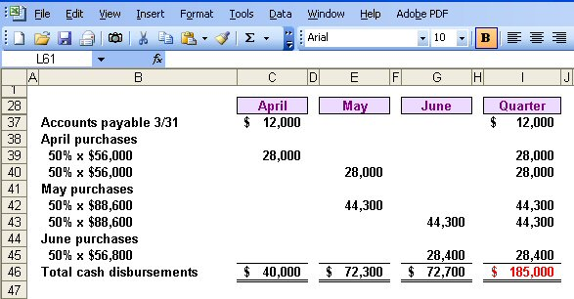
Expected Cash Disbursement for Materials
Notes:
The computations are very similar to those we made for the expected cash collections on sales.
Now let’s move to the direct labor budget.

Slide 47
Learning Objective 5
Prepare a direct labor budget.
Notes:
Learning objective number 5 is to prepare a direct labor budget.

Slide 48
The Direct Labor Budget
At Royal, each unit of product requires 0.05 hours (3 minutes) of direct labor.
The Company has a “no layoff” policy so all employees will be paid for 40 hours of work each week.
In exchange for the “no layoff” policy, workers agree to a wage rate of $10 per hour regardless of the hours worked (no overtime pay).
For the next three months, the direct labor workforce will be paid for a minimum of 1,500 hours per month.
Let’s prepare the direct labor budget.
Notes:
Carefully review the information on the screen. A unique aspect of direct labor at Royal is the no overtime policy. The company agrees to no layoffs of employees if work is slow, but in return, pays its employees straight time at $10 per hour for all hours worked. With the current work force, Royal will have to pay for a minimum of 1,500 hours of direct labor regardless of the work available.
Let’s prepare this budget.

Slide 49
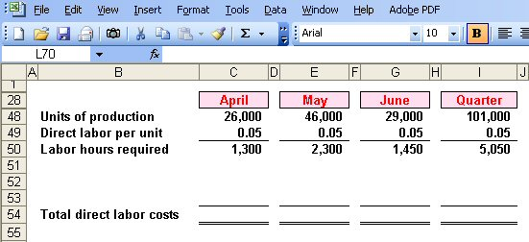
The Direct Labor Budget
From production budget.
Notes:
The first step in preparing the direct labor budget is to insert the production in units from the production budget.

Slide 50
The Direct Labor Budget
Notes:
Once again, we start with our production budget computations. We multiply the units of production by the time required to produce one unit to determine that we will require 1,300 direct labor hours in April, 2,300 direct labor hours in May, and 1,450 direct labor hours in June.

Slide 51
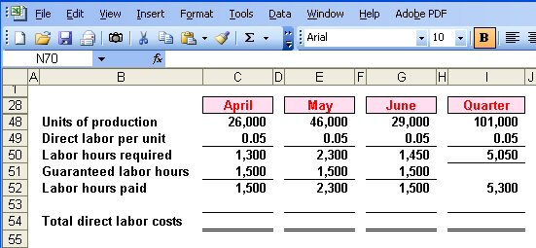
The Direct Labor Budget
Greater of labor hours required
or labor hours guaranteed.
Notes:
Because of the no layoff policy, Royal is committed to paying for a minimum of 1,500 hours per month. The number of hours paid will be the greater of the direct labor hours required, or 1,500 hours.
In April, Royal will pay for 1,500 direct labor hours when there is only work for 1,300 hours. In May, Royal will pay for 2,300 direct labor hours, and the company will pay for 1,500 hours in June. For the quarter, the company will pay for 5,300 direct labor hours.

Slide 52
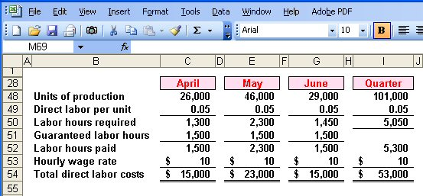
The Direct Labor Budget
Notes:
With a straight time rate of $10 per hour, Royal will pay $15,000 for direct labor in April, $23,000 in May, and $1,500 in June, for a total of $53,000 for the quarter.

Slide 53
Quick Check ✓
What would be the total direct labor cost for the quarter if the company follows its no lay-off policy, but pays $15 (time-and-a-half) for every hour worked in excess of 1,500 hours in a month?
  a. $79,500
  b. $64,500
  c. $61,000
  d. $57,000
Notes:
Determine the total direct labor costs if Royal were to pay time-and-one-half for all hours in excess of 1,500 hours per month.

Slide 54
Quick Check ✓
What would be the total direct labor cost for the quarter if the company follows its no lay-off policy, but pays $15 (time-and-a-half) for every hour worked in excess of 1,500 hours in a month?
  a. $79,500
  b. $64,500
  c. $61,000
  d. $57,000
Notes:
How did you do? The table on the right shows the detail computations.
Now let’s look at the manufacturing overhead budget.

Slide 55
Learning Objective 6
Prepare a manufacturing overhead budget.
Notes:
Learning objective number 6 is to prepare a manufacturing overhead budget.

Slide 56
Manufacturing Overhead Budget
At Royal, manufacturing overhead is applied to units of product on the basis of direct labor hours.
The variable manufacturing overhead rate is $20 per direct labor hour.
Fixed manufacturing overhead is $50,000 per month and includes $20,000 of noncash costs (primarily depreciation of plant assets).
Let’s prepare the manufacturing overhead budget.
Notes:
Royal applies overhead on the basis of direct labor hours. The variable manufacturing overhead rate is $25 per direct labor hour. The fixed overhead is $50,000 per month, of which $25,000 is noncash costs, primarily depreciation on the factory assets.

Slide 57
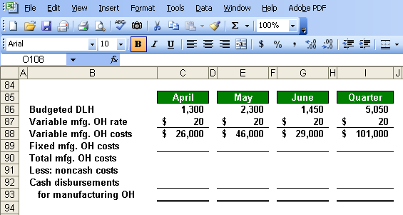
Manufacturing Overhead Budget
Direct Labor Budget.
Notes:
We begin by multiplying our variable manufacturing overhead rate of $25 times the number of direct labor hours used in the month. For April, we expect to apply $26,000 of variable overhead.

Slide 58
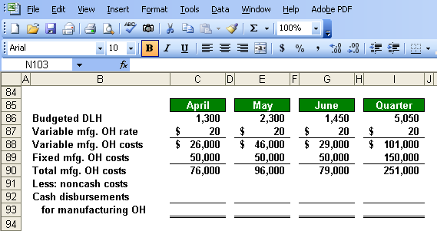
Manufacturing Overhead Budget
Total mfg. OH for quarter $251,000
Total labor hours required 5,050
= $49.70 per hour *
* rounded
Notes:
Next, we add the fixed overhead to our calculation of the variable overhead rate. We estimate total overhead of $76,000 in April and for the quarter, we expect a total of $251,000.
If we divide the manufacturing overhead of $251,000 by the total labor hours required during the quarter, we get a predetermined overhead rate of $49.70 (rounded). Remember, when determining the overhead rate we use the total labor hours required rather than the hours paid.

Slide 59
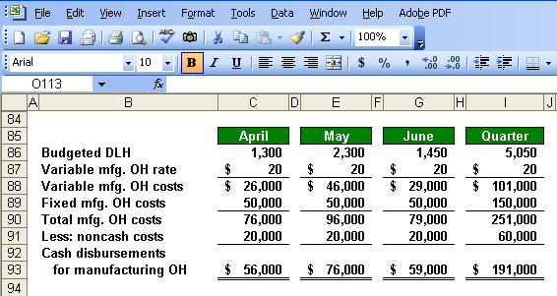
Manufacturing Overhead Budget
Depreciation is a noncash charge.
Notes:
If we subtract the noncash overhead costs from the total manufacturing overhead costs, we get the cash paid for overhead costs. We will use this cash overhead amount in our cash budget.

Slide 60
Ending Finished Goods Inventory Budget
Direct materials
budget and information.
Notes:
Now, Royal can complete the ending finished goods inventory budget. For the direct materials portion of our product unit cost, we know that each unit requires 5 pounds of direct material at 40 cents per pound, for a total of $2.00 per unit.

Slide 61
Ending Finished Goods Inventory Budget
Direct labor budget.
Notes:
It takes 0.05 hours to produce one unit and the pay rate is $10 per hour. We have a direct labor cost per unit of 50 cents.

Slide 62
Ending Finished Goods Inventory Budget
Total mfg. OH for quarter $251,000
Total labor hours required 5,050
= $49.70 per hour *
Notes:
Royal uses adsorption costing for valuing inventory. We apply overhead on the basis of direct labor hours, so we multiply 0.05 times the predetermined rate of $49.70, and get overhead cost per unit of $49.70. Our total unit cost is $4.99.
Calculate the cost of our ending finished goods inventory.

Slide 63
Ending Finished Goods Inventory Budget
Production Budget.
Notes:
We estimate there will be 5,000 units in ending inventory and at a per unit cost of $4.99, we have a total cost of $24,950. The finished goods inventory will appear on our budgeted balance sheet.

Slide 64
Learning Objective 7
Prepare a selling and administrative expense budget.
Notes:
Learning objective number 7 is to prepare a selling and administrative expense budget.

Slide 65
Selling and Administrative Expense Budget
At Royal, the selling and administrative expenses budget is divided into variable and fixed components.
The variable selling and administrative expenses are $0.50 per unit sold.
Fixed selling and administrative expenses are $70,000 per month.
The fixed selling and administrative expenses include $10,000 in costs – primarily depreciation – that are not cash outflows of the current month.
Let’s prepare the company’s selling and administrative expense budget.
Notes:
Royal has a variable and fixed component to its selling and administrative expenses. The company estimates variable selling and administrative expenses at 50 cents per unit sold. Fixed selling and administrative expenses are estimated at $70,000 per month. Of this amount, $10,000 are noncash expenses, primarily depreciation.
The selling and administrative expense budget will be prepared in a manner similar to our overhead budget.

Slide 66
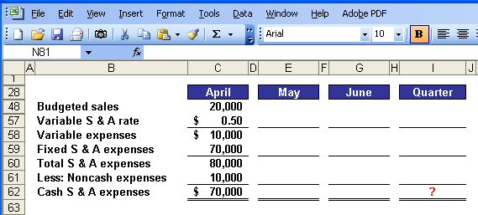
Selling and Administrative Expense Budget
Calculate the selling and administrative
cash expenses for the quarter.
Notes:
Variable selling and administrative expenses are based on units sold. In April, we expect to sell 20,000 units and apply the variable rate of 50 cents per unit.
To our variable expenses, we add our estimated $70,000 fixed selling and administrative expenses to get total selling and administrative expenses of $80,000.
Finally, we subtract the noncash portion of the fixed expenses to arrive at cash selling and administrative expenses for April of $70,000.
Take a few minutes to complete the schedule and see what kind of progress you are making.

Slide 67
Quick Check ✓
What are the total cash disbursements for selling and administrative expenses for the quarter?
  a. $180,000
  b. $230,000
  c. $110,000
  d. $ 70,000
Notes:
What are the total cash selling and administrative expenses for the quarter?

Slide 68
Quick Check ✓
What are the total cash disbursements for selling and administrative expenses for the quarter?
  a. $180,000
  b. $230,000
  c. $110,000
  d. $ 70,000
Notes:
Did you get $230,000? Let’s look at the schedule on the next screen and compare it to your work.

Slide 69
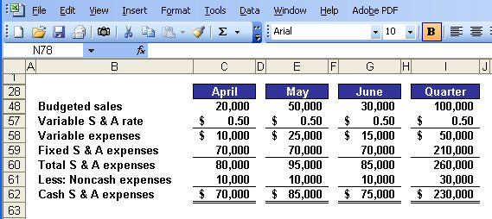
Selling and Administrative Expense Budget
Notes:
You can see how similar this schedule is to the manufacturing overhead schedule.

Slide 70
Learning Objective 8
Prepare a cash budget.
Notes:
Learning objective number 8 is to prepare a cash budget.

Slide 71
Format of the Cash Budget
The cash budget is divided into four sections:
Cash receipts listing all cash inflows excluding borrowing;
Cash disbursements listing all payments excluding repayments of principal and interest;
Cash excess or deficiency; and
The financing section listing all borrowings, repayments and interest.
Notes:
The preparation of the cash budget can be quite complex. We have to pay close attention to details from our other budgets if we are to be successful in preparing the cash budget.
On your screen, we listed the four major sections of the cash budget. As we prepare the budget, you will clearly see these four sections.

Slide 72
The Cash Budget
Royal:
  Maintains a 16% open line of credit for $75,000
  Maintains a minimum cash balance of $30,000
  Borrows on the first day of the month and repays loans on the last day of the month
  Pays a cash dividend of $49,000 in April
  Purchases $143,700 of equipment in May and $48,300 in June (both purchases paid in cash)
  Has an April 1 cash balance of $40,000
Notes:
It would be a good idea to jot down this additional information or merely print the screen. We will need all of this information to prepare the cash budget.

Slide 73
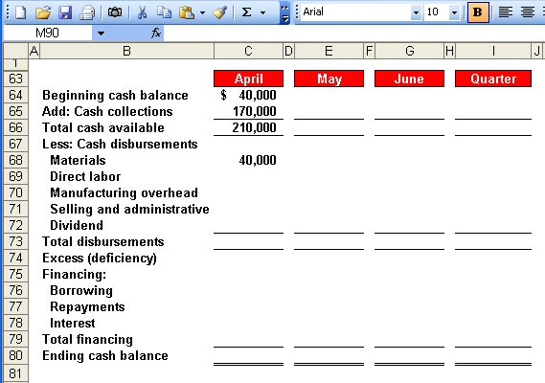
The Cash Budget
Schedule of Expected
Cash Collections.
Notes:
We began April with $40,000 in cash. To this amount, we add our expected cash collections from sales of $170,000 for the month of April. We complete the first section by calculating the total cash available of $210,000.
Now, let’s continue with the budget preparation.

Slide 74
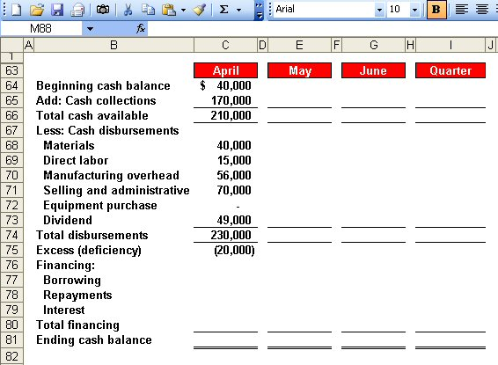
The Cash Budget
Schedule of Expected
Cash Disbursements.
Direct Labor
Budget.
Manufacturing
Overhead Budget.
Selling and Administrative
Expense Budget.
Notes:
During April, we expect to pay $40,000 for raw materials, $15,000 for direct labor, $56,000 for cash manufacturing overhead, and $70,000 for selling and administrative expense. This is not the total manufacturing overhead because we have excluded noncash depreciation costs.
During April, the Board of Directors paid a cash dividend of $49,000.
We have not completed the second major section of the cash budget, the cash disbursements.

Slide 75
The Cash Budget
Because Royal maintains
a cash balance of $30,000,
the company must borrow $50,000 on its line-of-credit.
Notes:
The third section of the cash budget is to determine any cash excess or deficiency. In the month of April, we expect to have a cash deficiency of $20,000. Since Royal has a policy that the company will always maintain an ending cash balance of $30,000, it will have to borrow $15,000 against its line-of-credit in April.

Slide 76
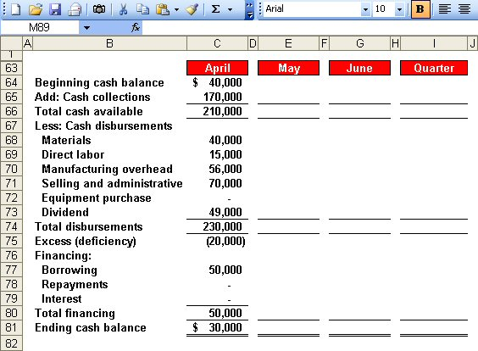
The Cash Budget
Ending cash balance for April
is the beginning May balance.
Notes:
After Royal borrows on its line-of-credit, it will have an ending cash balance of $30,000 dollars. The ending cash balance for April becomes the beginning cash balance for May.
Let’s complete the cash budget for the month of May.

Slide 77
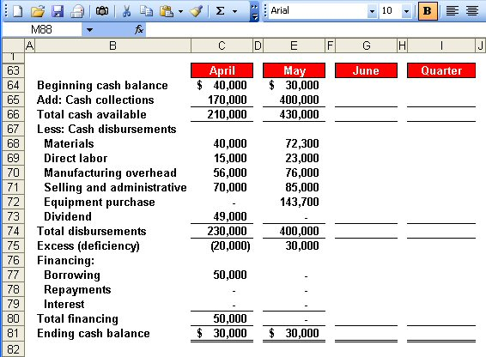
The Cash Budget
Notes:
Refer back to our previous budgets to get the cash collection, cash disbursements for direct materials, direct labor, manufacturing overhead, and selling and administrative expenses. The new item in May is that the company plans to purchase $143,000 worth of equipment.
For May, the company will have a cash excess of $30,000, but it will not be able to repay the monies borrowed on the line-of-credit or the accrued interest.
It’s your turn to calculate the cash excess or deficiency for the month of June.

Slide 78
Quick Check ✓
What is the excess (deficiency) of cash available over disbursements for June?
  a. $ 85,000
  b. $(10,000)
  c. $ 75,000
  d. $ 95,000
Notes:
Which amount did you determine to be correct?

Slide 79
Quick Check ✓
What is the excess (deficiency) of cash available over disbursements for June?
  a. $ 85,000
  b. $(10,000)
  c. $ 75,000
  d. $ 95,000
Notes:
$95,000 is the correct answer. Let’s look at the completed schedule on the next screen.

Slide 80
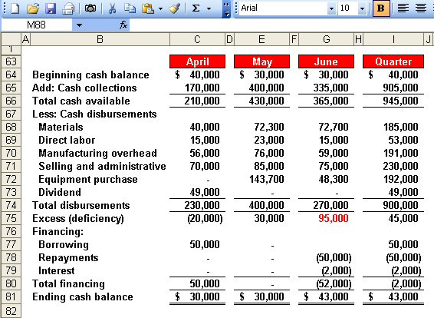
The Cash Budget
$50,000 × 16% × 3/12 = $2,000
Borrowings on April 1 and
repayment on June 30.
Notes:
You can see the cash excess of $95,000.
At the end of June, Royal will have sufficient cash to repay the $50,000 borrowed in April plus the interest on the loan. The total interest is $2,000 as demonstrated in the computation of interest box on the left side of your screen.
Royal will end the quarter with $43,000 cash on hand. This cash balance will appear on our budgeted balance sheet.

Slide 81
The Budgeted Income Statement
Cash
Budget
Budgeted
Income
Statement
Completed
After we complete the cash budget, we can prepare the budgeted income statement for Royal.
Notes:
We are now ready to move from the preparation of individual budgets to compiling our budgeted financial statements. Let’s begin with the budgeted income statement.

Slide 82
Learning Objective 9
Prepare a budgeted income statement.
Notes:
Learning objective number 9 is to prepare a budgeted income statement.

Slide 83
The Budgeted Income Statement
Sales Budget.
Ending Finished
Goods Inventory.
Selling and
Administrative
Expense Budget.
Cash Budget.
Notes:
Recall that Royal planned to sell 100,000 units during the quarter at $10 per unit.
We determined the unit cost at $4.99, so cost of goods sold will be $499,000.
Our selling and administrative expenses, including depreciation, total $260,000, and we incurred $2,000 of interest expense during the quarter.
Our budgeted net income for the quarter is $239,000.
With the income statement complete, we can move on to the budgeted balance sheet.

Slide 84
Learning Objective 10
Prepare a budgeted balance sheet.
Notes:
Learning objective number 10 is to prepare a budgeted balance sheet.

Slide 85
The Budgeted Balance Sheet
Royal reported the following account balances prior to preparing its budgeted financial statements:
  Land - $50,000
  Common stock - $200,000
  Retained earnings - $146,150
  Equipment - $175,000
Notes:
Please make note of this supplemental information as we will need it to complete the budgeted balance sheet.

Slide 86
25% of June
sales of
$300,000.
11,500 lbs.
at $0.40/lb.
5,000 units
at $4.99 each.
50% of June
purchases
of $56,800.
Notes:
You can see our cash balance of $43,000 that comes directly from the cash budget. The other current assets and liabilities are explained in the boxes to the right. We provided you with supplemental information about land, equipment, and common stock.
On the next screen, we will prepare a statement of retained earnings.

Slide 87
Notes:
We provided you with the beginning balance in retained earnings. To arrive at the ending balance in retained earnings, we need to add the budgeted net income of $239,000 and subtract the cash dividend of $49,000 paid in April.

Slide 88
End of Chapter 8
Notes:
End of chapter 9.

