Slide 1
Prepared by
Coby Harmon
University of California, Santa Barbara
Westmont College

Slide 2
18
Financial Statement Analysis
Learning Objectives
After studying this chapter, you should be able to:
[1] Discuss the need for comparative analysis.
[2] Identify the tools of financial statement analysis.
[3] Explain and apply horizontal analysis.
[4] Describe and apply vertical analysis.
[5] Identify and compute ratios used in analyzing a firm’s liquidity, profitability, and solvency.
[6] Understand the concept of earning power, and how irregular items are presented.
[7] Understand the concept of quality of earnings.

Slide 3
Preview of Chapter 18
Accounting Principles
Eleventh Edition
Weygandt Kimmel Kieso

Slide 4
Ratio Analysis
Ratio analysis expresses the relationship among selected items of financial statement data.
Financial Ratio Classifications
Liquidity
Profitability
Solvency
Measures short-term ability of the company to pay its maturing obligations and to meet unexpected needs for cash.
Measures the income or operating success of a company for a given period of time.
Measures the ability of the company to survive over a long period of time.
LO 5 Identify and compute ratios used in analyzing a firm’s liquidity, profitability, and solvency.

Slide 5
Ratio Analysis
A single ratio by itself is not very meaningful.
The discussion of ratios will include the following types of comparisons.
Intracompany comparisons for two years for Quality Department Store.
Industry average comparisons based on median ratios for department stores.
Intercompany comparisons based on Macy’s, Inc. as Quality Department Store’s principal competitor.
LO 5 Identify and compute ratios used in analyzing a firm’s liquidity, profitability, and solvency.

Slide 6
Ratio Analysis
Liquidity Ratios
Measure the short-term ability of the company to pay its maturing obligations and to meet unexpected needs for cash.
Short-term creditors such as bankers and suppliers are particularly interested in assessing liquidity.
Ratios include the current ratio, the acid-test ratio, accounts receivable turnover, and inventory turnover.
LO 5 Identify and compute ratios used in analyzing a firm’s liquidity, profitability, and solvency.

Slide 7
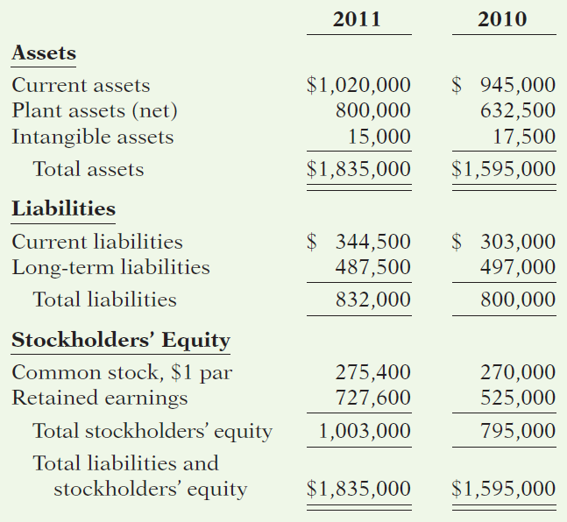
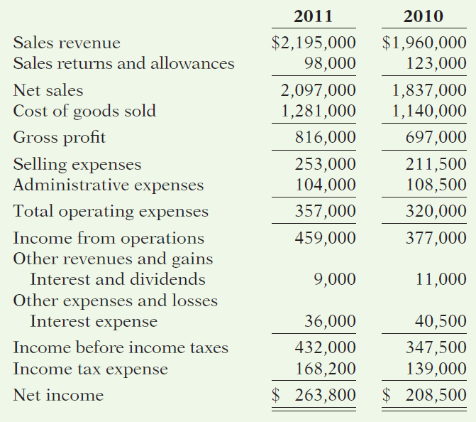
QUALITY DEPARTMENT STORE INC.
Condensed Balance Sheets
For the Years Ended December 31
QUALITY DEPARTMENT STORE INC.
Condensed Income Statements
For the Years Ended December 31
Illustration 18-12
Advance slide in presentation mode to reveal solution.
LO 5

Slide 8
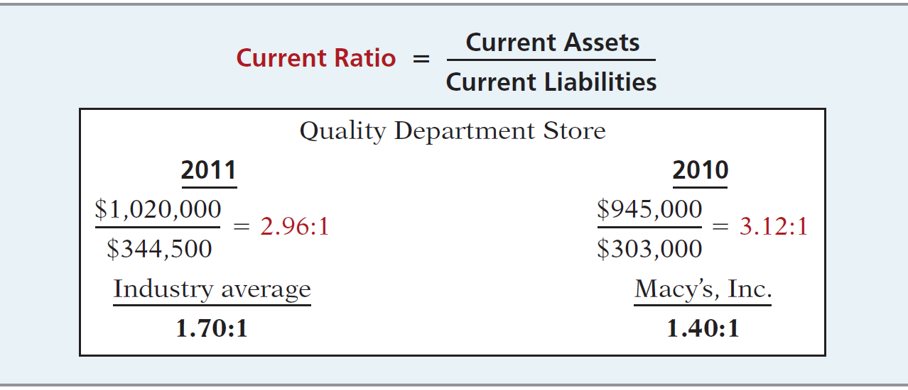
Liquidity Ratios
Ratio Analysis
Current Ratio
Illustration 18-12
Ratio of 2.96:1 means that for every dollar of current liabilities, Quality has $2.96 of current assets.
LO 5 Identify and compute ratios used in analyzing a firm’s liquidity, profitability, and solvency.

Slide 9
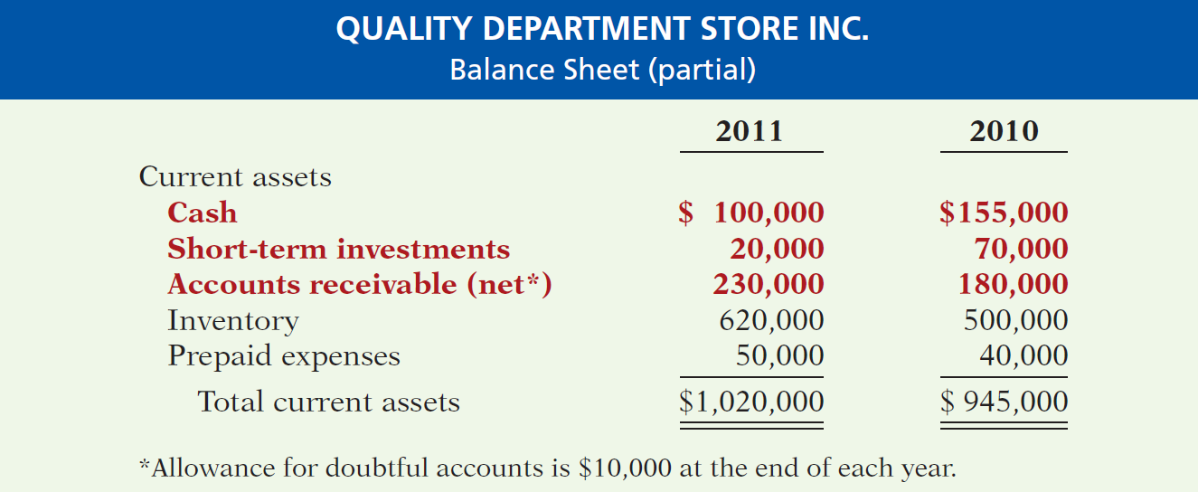
Liquidity Ratios
Ratio Analysis
Acid-Test Ratio
Illustration 18-13
LO 5 Identify and compute ratios used in analyzing a firm’s liquidity, profitability, and solvency.

Slide 10
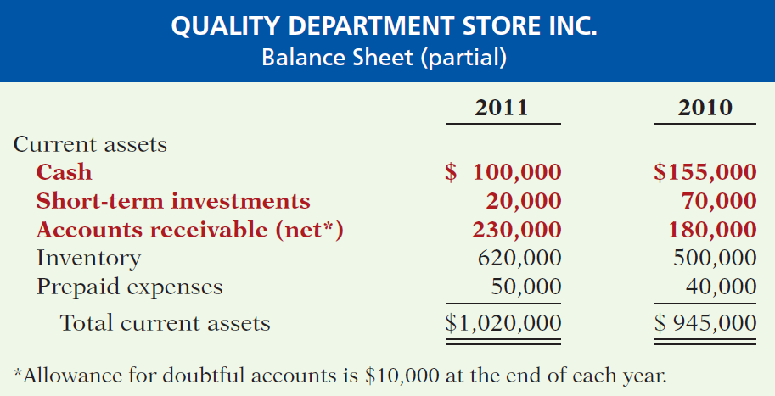
QUALITY DEPARTMENT STORE INC.
Condensed Balance Sheets
For the Years Ended December 31
QUALITY DEPARTMENT STORE INC.
Balance Sheet (partial)
For the Years Ended December 31
Illustration 18-12
LO 5

Slide 11
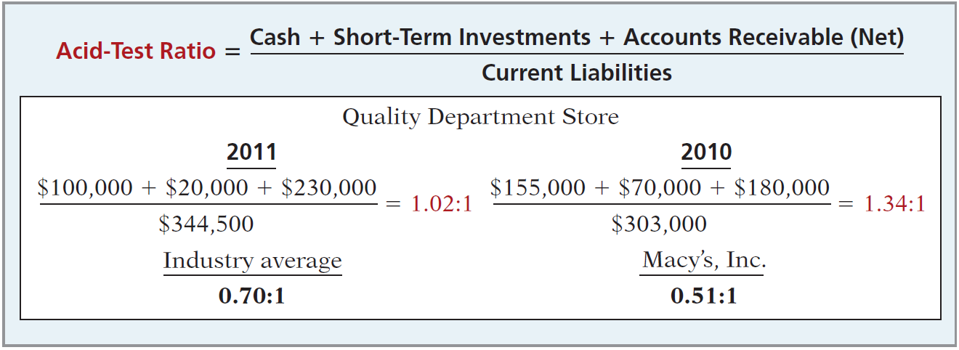
Liquidity Ratios
Ratio Analysis
Acid-Test Ratio
Illustration 18-14
Acid-test ratio measures immediate liquidity.
LO 5 Identify and compute ratios used in analyzing a firm’s liquidity, profitability, and solvency.

Slide 12
QUALITY DEPARTMENT STORE INC.
Balance Sheet (partial)
For the Years Ended December 31
QUALITY DEPARTMENT STORE INC.
Condensed Income Statements
For the Years Ended December 31
LO 5

Slide 13
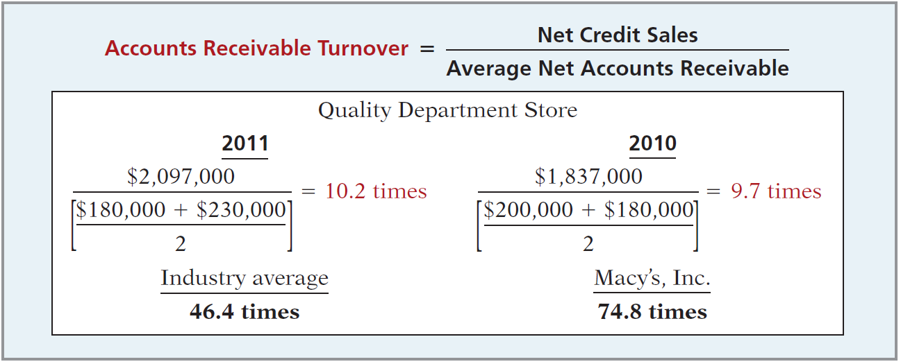
Liquidity Ratios
Ratio Analysis
Accounts Receivable Turnover
Illustration 18-15
Measures the number of times, on average, the company collects receivables during the period.
LO 5

Slide 14
Liquidity Ratios
Ratio Analysis
Accounts Receivable Turnover
$2,097,000
= 10.2 times
($180,000 + $230,000) / 2
A variant of the accounts receivable turnover ratio is to convert it to an average collection period in terms of days.
365 days / 10.2 times = every 35.78 days
Accounts receivable are collected on average every 36 days.
LO 5 Identify and compute ratios used in analyzing a firm’s liquidity, profitability, and solvency.

Slide 15
QUALITY DEPARTMENT STORE INC.
Balance Sheet (partial)
For the Years Ended December 31
QUALITY DEPARTMENT STORE INC.
Condensed Income Statements
For the Years Ended December 31
Illustration 18-12
LO 5

Slide 16
Liquidity Ratios
Ratio Analysis
Inventory Turnover
Illustration 18-16
Measures the number of times, on average, the inventory is sold during the period.
LO 5

Slide 17
Liquidity Ratios
Ratio Analysis
Inventory Turnover
$1,281,000
= 2.3 times
($500,000 + $620,000) / 2
A variant of inventory turnover is the days in inventory.
365 days / 2.3 times = every 159 days
Inventory turnover ratios vary considerably among industries.
LO 5 Identify and compute ratios used in analyzing a firm’s liquidity, profitability, and solvency.

Slide 18
Ratio Analysis
Profitability Ratios
Measure the income or operating success of a company for a given period of time.
Income, or the lack of it, affects the company’s ability to obtain debt and equity financing, liquidity position, and the ability to grow.
Ratios include the profit margin, asset turnover, return on assets, return on common stockholders’ equity, earnings per share, price-earnings, and payout ratio.
LO 5 Identify and compute ratios used in analyzing a firm’s liquidity, profitability, and solvency.

Slide 19
QUALITY DEPARTMENT STORE INC.
Condensed Balance Sheets
For the Years Ended December 31
QUALITY DEPARTMENT STORE INC.
Condensed Income Statements
For the Years Ended December 31
LO 5

Slide 20
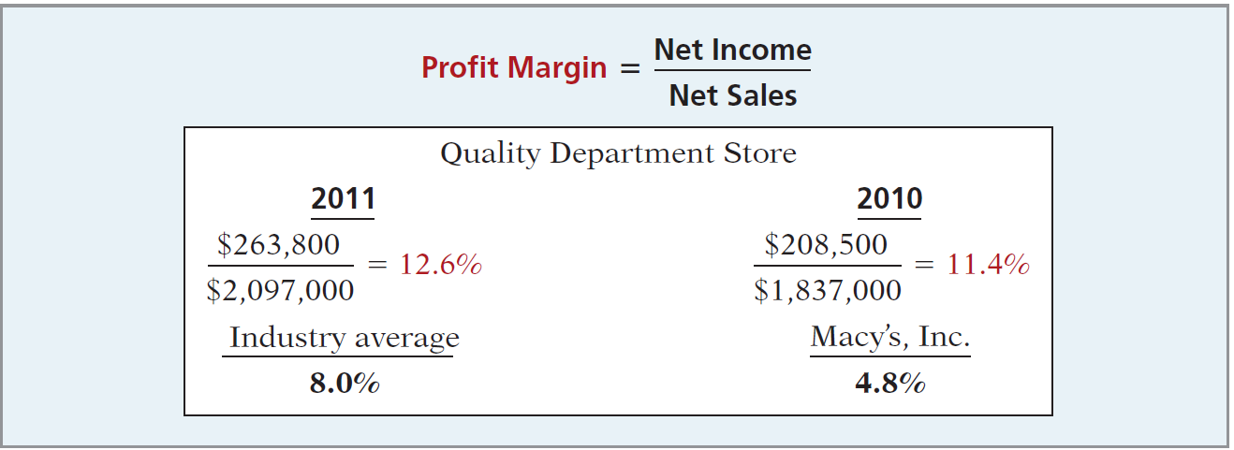
Profitability Ratios
Ratio Analysis
Profit Margin
Illustration 18-17
Measures the percentage of each dollar of sales that results in net income.
LO 5 Identify and compute ratios used in analyzing a firm’s liquidity, profitability, and solvency.

Slide 21
QUALITY DEPARTMENT STORE INC.
Condensed Balance Sheets
For the Years Ended December 31
QUALITY DEPARTMENT STORE INC.
Condensed Income Statements
For the Years Ended December 31
Illustration 18-12
LO 5

Slide 22
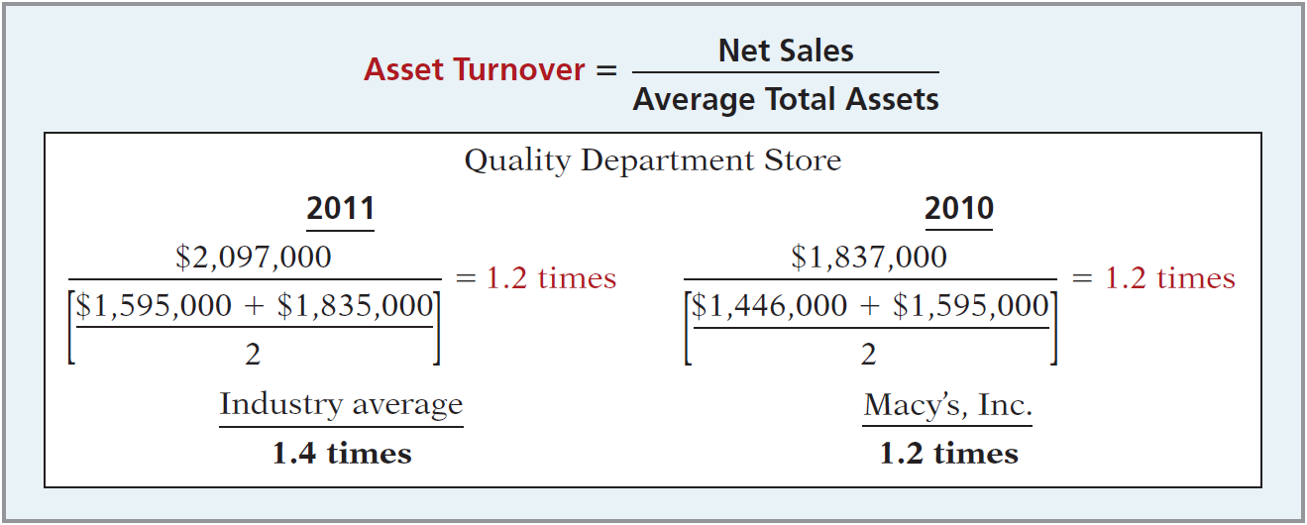
Profitability Ratios
Ratio Analysis
Asset Turnover
Illustration 18-18
Measures how efficiently a company uses its assets to generate sales.
LO 5 Identify and compute ratios used in analyzing a firm’s liquidity, profitability, and solvency.

Slide 23
QUALITY DEPARTMENT STORE INC.
Condensed Balance Sheets
For the Years Ended December 31
QUALITY DEPARTMENT STORE INC.
Condensed Income Statements
For the Years Ended December 31
Illustration 18-12
LO 5

Slide 24
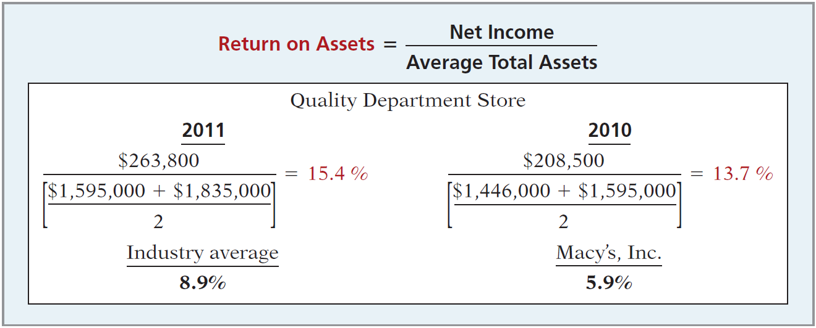
Profitability Ratios
Ratio Analysis
Return on Asset
Illustration 18-19
An overall measure of profitability.
LO 5 Identify and compute ratios used in analyzing a firm’s liquidity, profitability, and solvency.

Slide 25
QUALITY DEPARTMENT STORE INC.
Condensed Balance Sheets
For the Years Ended December 31
QUALITY DEPARTMENT STORE INC.
Condensed Income Statements
For the Years Ended December 31
Illustration 18-12
LO 5

Slide 26
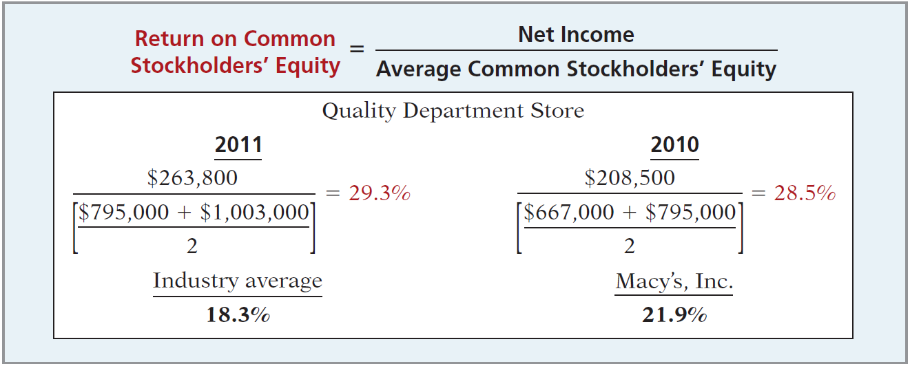
Profitability Ratios
Ratio Analysis
Return on Common Stockholders’ Equity
Illustration 18-20
Shows how many dollars of net income the company earned for each dollar invested by the owners.
LO 5

Slide 27
QUALITY DEPARTMENT STORE INC.
Condensed Balance Sheets
For the Years Ended December 31
QUALITY DEPARTMENT STORE INC.
Condensed Income Statements
For the Years Ended December 31
Illustration 18-12
LO 5

Slide 28
Profitability Ratios
Ratio Analysis
Earnings Per Share (EPS)
Illustration 18-22
A measure of the net income earned on each share of common stock.
LO 5

Slide 29
QUALITY DEPARTMENT STORE INC.
Condensed Balance Sheets
For the Years Ended December 31
QUALITY DEPARTMENT STORE INC.
Condensed Income Statements
For the Years Ended December 31
Illustration 18-12
LO 5

Slide 30
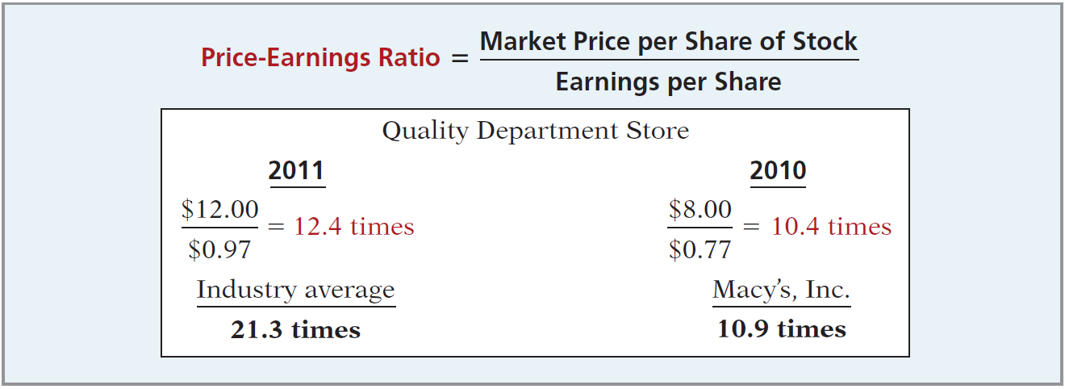
Profitability Ratios
Ratio Analysis
Price-Earnings Ratio
Illustration 18-23
Measures the net income earned on each share of common stock.
LO 5

Slide 31
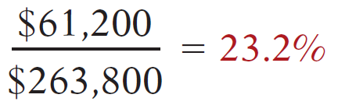
QUALITY DEPARTMENT STORE INC.
Condensed Balance Sheets
For the Years Ended December 31
QUALITY DEPARTMENT STORE INC.
Condensed Income Statements
For the Years Ended December 31
Illustration 18-12
LO 5

Slide 32
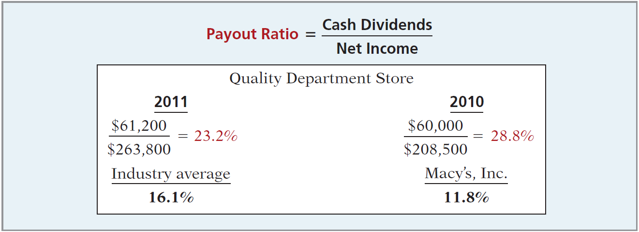
Profitability Ratios
Ratio Analysis
Payout Ratio
Illustration 18-24
Measures the percentage of earnings distributed in the form of cash dividends.
LO 5

Slide 33
Ratio Analysis
Solvency Ratios
Solvency ratios measure the ability of a company to survive over a long period of time.
Debt to Assets and
Times Interest Earned
are two ratios that provide information about debt-paying ability.
LO 5 Identify and compute ratios used in analyzing a firm’s liquidity, profitability, and solvency.

Slide 34
QUALITY DEPARTMENT STORE INC.
Condensed Balance Sheets
For the Years Ended December 31
QUALITY DEPARTMENT STORE INC.
Condensed Income Statements
For the Years Ended December 31
Illustration 18-12
LO 5

Slide 35
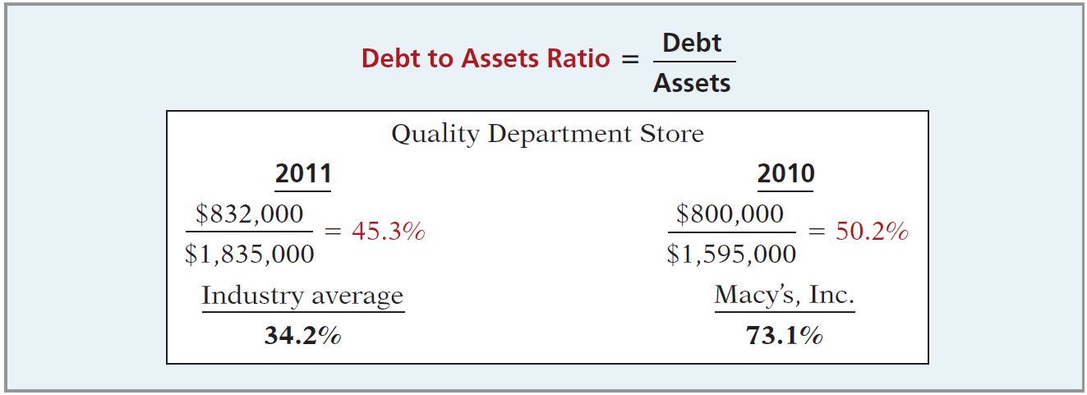
Solvency Ratios
Ratio Analysis
Debt to Total Assets Ratio
Illustration 18-25
Measures the percentage of the total assets that creditors provide.
LO 5

Slide 36
QUALITY DEPARTMENT STORE INC.
Condensed Balance Sheets
For the Years Ended December 31
QUALITY DEPARTMENT STORE INC.
Condensed Income Statements
For the Years Ended December 31
Illustration 18-12
LO 5

Slide 37
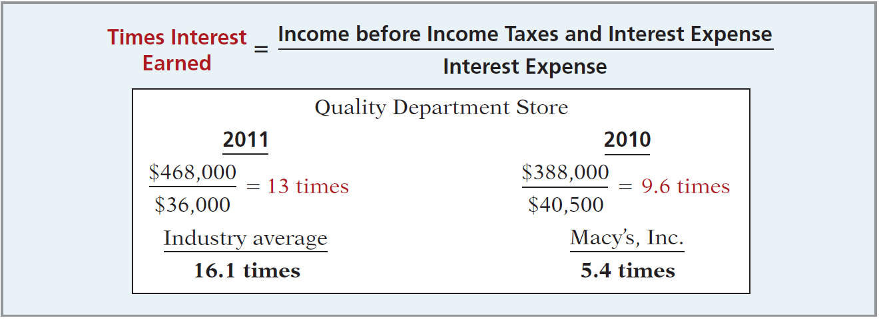
Solvency Ratios
Ratio Analysis
Times Interest Earned
Illustration 18-25
Provides an indication of the company’s ability to meet interest payments as they come due.
LO 5

Slide 38
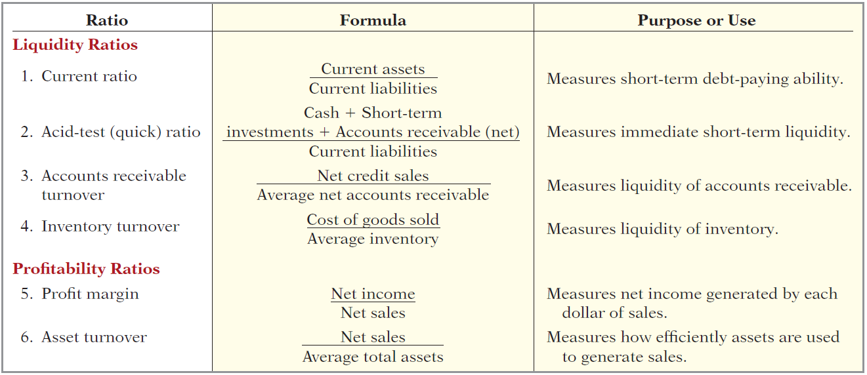
Ratio Analysis
Summary of Ratios
Illustration 18-27
LO 5

Slide 39
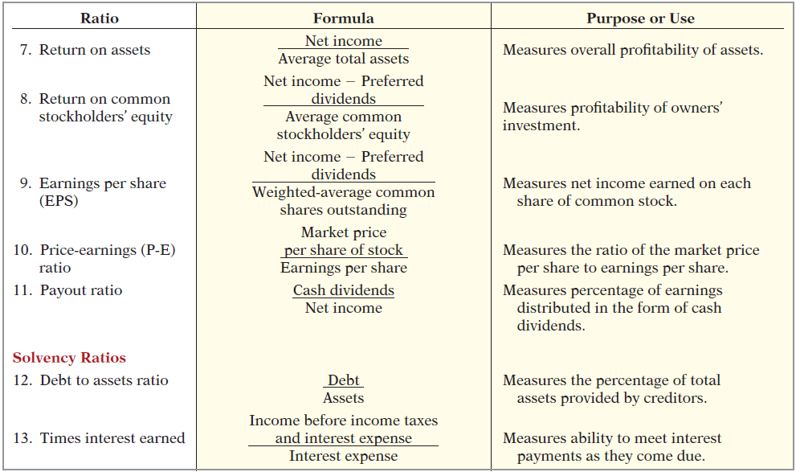
Summary of Ratios
Illustration 18-27
LO 5

